Slide 1

Chapter 11 Disc Scheduling

Slide 2
CS 345
Stalling’s Chapter | # | Project
1: Computer System Overview 2: Operating System Overview | 4 | P1: Shell
3: Process Description and Control 4: Threads | 4 | P2: Tasking
5: Concurrency: ME and Synchronization 6: Concurrency: Deadlock and Starvation | 6 | P3: Jurassic Park
7: Memory Management 8: Virtual memory | 6 | P4: Virtual Memory
9: Uniprocessor Scheduling 10: Multiprocessor and Real-Time Scheduling | 6 | P5: Scheduling
11: I/O Management and Disk Scheduling 12: File Management | 8 | P6: FAT
Student Presentations | 6

Slide 3
Chapter 11 Learning Objectives
After studying this chapter, you should be able to:
Summarize key categories of I/O devices on computers.
Discuss the organization of the I/O function.
Explain some of the key issues in the design of OS support for I/O.
Analyze the performance implications of various I/O buffering alternatives.
Understand the performance issues involved in magnetic disk access.
Explain the concept of RAID and describe the various levels.
Understand the performance implications of disk cache.
Describe the I/O mechanisms in UNIX, Linux, and Windows 7.

Slide 4
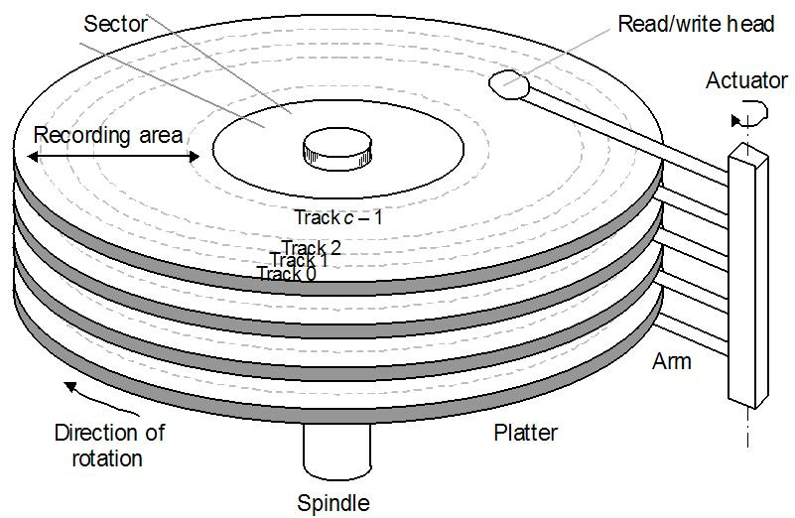
Disk Structure
Addressed as a one dimensional array of logical sectors
Logical mapping to physical sectors on disk
Sectors are smallest addressable blocks (usually 512 bytes)
Clusters composed of one or more sectors
Simple, but……..
Defective sectors
Hidden by substituting sectors from elsewhere
Number of sectors per track is not constant
40% more sectors on outside track
0 | 512 bytes
1 | 512 bytes
2 | 512 bytes
3 | 512 bytes
4 | 512 bytes
5 | 512 bytes
6 | 512 bytes
7 | 512 bytes
8 | 512 bytes
9 | 512 bytes
10 | 512 bytes
11 | 512 bytes
12 | 512 bytes
13 | 512 bytes
14 | 512 bytes
… | …

Slide 5
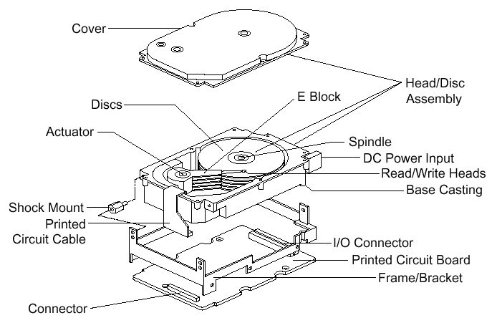
Disk Structure

Slide 6
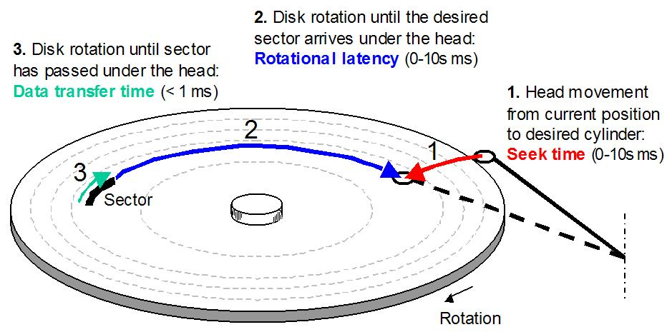
Disk speed

Slide 7
Disk Performance
Much slower than memory
Typical disk speed: 4-10 ms (10⁻³ s)
Typical memory speed: 1-10 ns (10⁻⁹ s)
I/O bus Protocols
EIDE – Enhanced Integrated Drive Electronics
ATA – Advanced Technology Attachment
SATA – Serial ATA
USB – Universal Serial Bus
FC – Fiber Channel
SCSI – Small Computer System Interface
SAS – Serial SCSI
IDE – Integrated Disk Electronics

Slide 8


Effective Transfer Rates
Performance measures
Seek Time – Time to move the heads
Approximation ≈ (# of tracks × c) + startup/settle time
Rotational Delay – Waiting for the correct sector to move under the head
Average 1/2 rotation
HD: 5400rpm → 5.6ms, 10000rpm → 3ms
Floppy: 300 rpm → 100ms
Effective Times
Access Time – Sum of seek time and rotational delay
Transfer Time – Actual time needed to perform the read or write
Time depends on locality

Slide 9
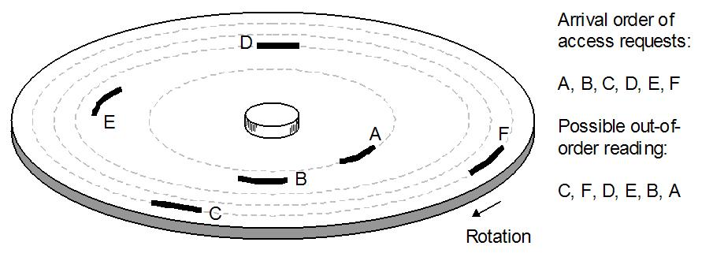
Disk scheduling
When a read/write job is requested, the disk may currently be busy
All pending jobs are placed in a disk queue
could be scheduled to improve the utilization
Disk scheduling increases the disk’s bandwidth
(the amount of information that can be transferred in a set amount of time)

Slide 10
Disk Scheduling
Random
Select a random request to do next
Worst possible performance, but useful for comparisons
FIFO
Do in the order they arrive
Simple and fair in that all requests are honored
Poor performance if requests are not clustered
Especially true in multiprogramming systems
Priority
Do operations for high-priority processes first
Not intended to optimize disk utilization, but to meet other objectives
Users may try to exploit priorities

Slide 11
Disk Scheduling
LIFO (Last-In First-Out)
Always take the most recent request
Hope to catch a sequence of reads at one time (locality)
Runs risk of starvation
SSTF (Shortest Service Time First)
Select the read closest to the current track next
Requires knowledge of arm position
Also has risk of starvation
SCAN
Arm moves in one direction, meeting all requests en route
If no more requests, switch directions
Bias against track just traversed
Will miss locality in the wrong direction
Favors innermost and outermost tracks; latest arriving jobs

Slide 12
Disk Scheduling
C-SCAN (circular SCAN)
Always scan in one direction
If no more requests, move to far end and start over
Reduces time for requests on edges
N-step Scan
Prevent one track from monopolizing disk (“arm stickiness”)
Have sub-queues of size N
Use SCAN for each sub-queue
FSCAN
When one scan begins, only existing requests are handled
New requests are put on a secondary queue
When a scan ends, take the queue entries and start a new scan

Slide 13
FCFS Scheduling
Cylinder Requests: 53, 98, 183, 37, 122, 14, 124, 65, 67
0 14 37 53 65 67 98 122 124 183 199

Slide 14
SSTF Scheduling (Shortest seek time first)
Cylinder Requests: 53, 98, 183, 37, 122, 14, 124, 65, 67
0 14 37 53 65 67 98 122 124 183 199
A form of Shortest Job First
Not optimal
May cause starvation

Slide 15
SCAN Scheduling (Scan one side to other)
Cylinder Requests: 53, 98, 183, 37, 122, 14, 124, 65, 67
0 14 37 53 65 67 98 122 124 183 199
Sometimes called the elevator algorithm
Think about requests when head reverses direction
- Just serviced those requests near disk head

Slide 16
C-SCAN Scheduling (Circular Scan)
Cylinder Requests: 53, 98, 183, 37, 122, 14, 124, 65, 67
0 14 37 53 65 67 98 122 124 183 199
Designed to provide more uniform wait time
Treat cylinders like a circular list

Slide 17
LOOK and C-LOOK
Cylinder Requests: 53, 98, 183, 37, 122, 14, 124, 65, 67
0 14 37 53 65 67 98 122 124 183 199
Don’t go all the way to the end cylinders
C-LOOK

Slide 18
Disk Scheduling Algorithms
Selection according to requestor
RSS | Random scheduling | For analysis & simulation
FIFO | First in first out | Fairest of them all
Priority | Priority by process | No disk optimization
LIFO | Last in first out | Max locality & resource
Selection according to requested item
SSTF | Shortest service time first | High utilization, small queues
SCAN | Back and forth over disk | Better service distribution
C-SCAN | One way with fast return | Lower service variability
N-step-SCAN | SCAN of N records at a time | Service guarantee
FSCAN | NsS w/N=queue at beginning of SCAN cycle | Load sensitive

Slide 19
Choosing an Algorithm
Seek time is the only thing that can be controlled
SSTF is commonly used (appealing)
SCAN & CSCAN perform better under heavy load
Why? (Think about starvation issues)
Can find optimal schedule but computation is expensive
In low use systems, FCFS is fine

Slide 20
Choosing an Algorithm
Head movement isn’t the only consideration
Rotational Latency
File system will play a part as well
Typically file systems generate requests to read or write a larger unit of data (say 64K) and this request will be passed to the disk as a command to read or write 128 sectors.
Hardware can help too
Caching a whole track at a time
The disk device initially transfers data to a memory chip in the disk controller circuitry.
The cheapest desktop computer disks have 2 megabytes of cache memory, while for a few dollars more you can get a disk with 8 megabytes.

Slide 21
Low-level Formatting
When made, a disk is just a magnetic plate
Low-level (or physical) formatting divides the disks into sectors
MFM, M2FM
Missing CLocks
Header data – 512 bytes trailer
Sector number
Disk controller info
ECC

Slide 22

Disk formatting
Logical formatting
file system structure is written onto the disk
Includes boot information (when requested) and FAT tables or inodes
Boot sector
contains enough instructions to start loading the OS from somewhere else
Called by bootstrap program in computer’s ROM

Slide 23
Bad blocks
In FAT, when a block gives an unrecoverable ECC error, the sector is marked bad (0xFF7) in the FAT
Bit mapped allocation just marks sector as used
Some systems keep a pool of spare blocks
when a block goes bad, maps the logical sector to one of the spare blocks
Same cylinder if possible
Sector slipping (push down a group to free up a sector)
Doesn’t recover the corrupted file, but does keep the same logical disk structure

Slide 24
Asynchronous I/O
Application makes request and proceeds
Ways to signal completion
Signal a device kernel object
Simple to handle
Cannot distinguish multiple requests regarding the same file
Signal a event kernel object
Can create a separate object for each request
Alertable I/O
I/O manager places results in APC (asynchronous procedure call) queue
I/O completion ports
Use a pool of threads to handle requests
RAID
Hardware – Done by disk controller
Software – System combines space

Slide 25
Swap Space
Swap Space
This is the area of the disk where processes or memory pages are written if the system needs more physical memory
Can be either set aside area of disk or part of the regular file system
Set aside an area of the disk for swap space:
Easier management and better performance
Requires special code
Part of file system:
Uses regular file functions
Slower to access and change

Slide 26
Reliability
Although disks are fairly reliable - they still fail on a regular basis
Redundant arrays of independent disks (RAID) are more reliable
Simplest forms have duplicate copies of each disk
Twice the cost but twice as fast when reading
Another type uses 1 parity block per 8 disk blocks
The parity can be used to recalculate the information in a bad block

Slide 27

RAID
Database designers recognize that a H/W component can only be pushed so far…
If the data is on separate disks, we can issue parallel commands
This can be individual requests or a single large request
Provide physical redundancy
Industry has a standard for multiple-disk database design: RAID - Redundant Array of Independent Disks
Key advantage:
Combines multiple low-cost devices using older technology into an array that offers greater capacity, reliability, speed, or a combination of these things, than is affordably available in a single device using the newest technology.

Slide 28
RAID
Common characteristics
Views a set of physical disks as a single logical entity
Data is distributed across the disks in the array
Use redundant disk capacity to be able to respond to disk failure
Addresses the need for redundancy
Caveat: More disks → more chance of failure

Slide 29
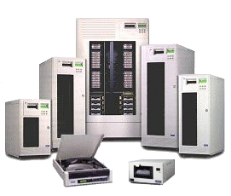

Raid Product Examples…
IBM ESS Model 750

Slide 30
Data Mapping for RAID 0 Array
Physical
Disk 0
Physical
Disk 1
Physical
Disk 2
Physical
Disk 3
strip 0
strip 1
strip 0
strip 1
strip 2
strip 3
strip 2
strip 4
strip 5
strip 6
strip 7
strip 3
strip 9
strip 10
strip 11
strip 4
strip 8
strip 12
strip 13
strip 14
strip 15
strip 5
strip 6
strip 7
strip 8
Array
Management
Software
strip 9
strip 10
strip11
strip 12
strip 13
strip 14
strip 15

Slide 31
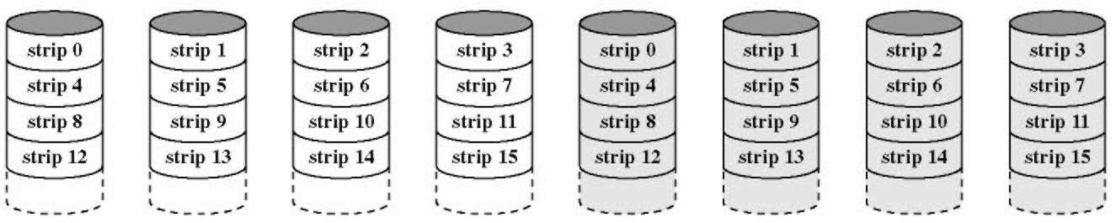
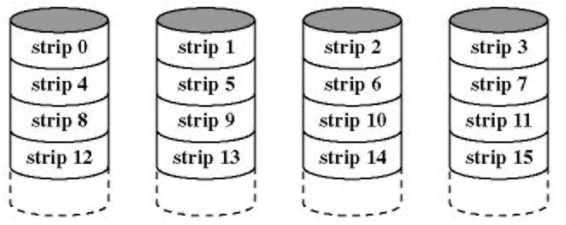
RAID
RAID 0: Strip Data
Use of multiple disks means that a single request can be handled in parallel
Greatly reduces I/O transfer time
Also may balance load across disks
Does not use redundancy
RAID 1: Mirror Data
Read from either disk; writes update both disks in parallel
Failure recovery easy
Principle disadvantage is cost

Slide 32
Hamming Codes
Forward Error Correction (FEC) refers to the ability of receiving station to correct a transmission error.
The transmitting station must append information to the data in the form of error correction bits, but the increase in frame length may be modest relative to the cost of re-transmission.
Hamming codes provide for FEC using a "block parity" mechanism that can be inexpensively implemented (XOR).
Hamming codes are used as an error detection mechanism to catch both single and double bit errors or to correct single bit error. This is accomplished by using more than one parity bit, each computed on different combination of bits in the data.

Slide 33
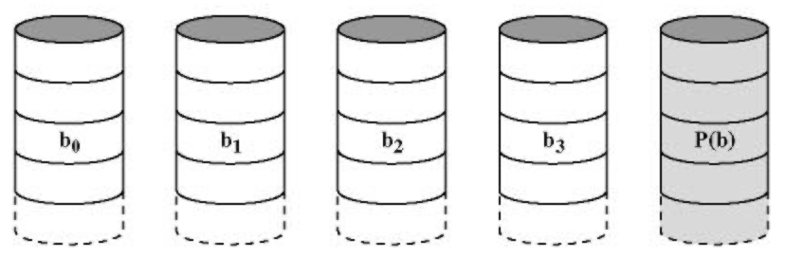
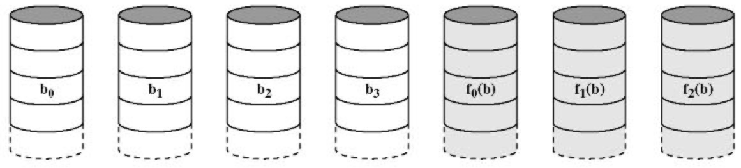
RAID (continued…)
RAID 2: Parallel Access w/Error Correction
All disks participate in each I/O request
Hamming codes correct single-bit errors, detect double-bit errors
Spindles synchronized
Strips small (byte or word)
Overkill – not used
RAID 3: Parity
Implements a single parity strip with a single redundant disk
Parity = data1 ⊕ data2 ⊕ data3 ⊕ ...
Missing data reconstructed using parity.
Capable of high data rates, but only
one I/O request at a time
Failure operates in reduced mode

Slide 34
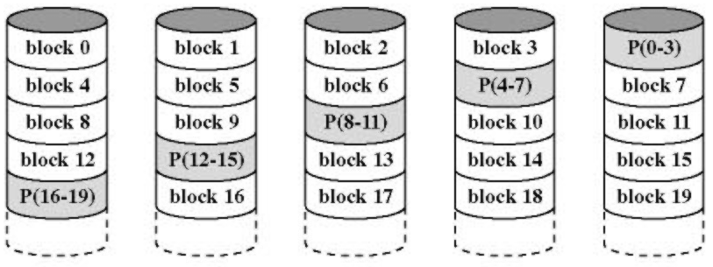
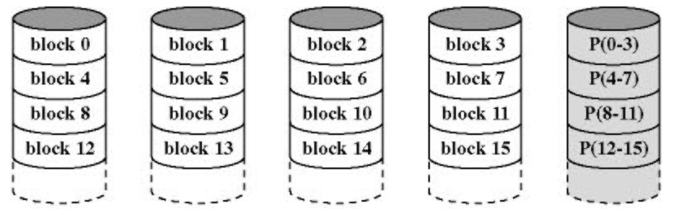
RAID (continued…)
RAID 4: Independent Access
Parity strip handled on a block basis
Parity strip must be updated on each write
Parity disk tends to be a bottleneck
RAID 5: Independent Access
Like RAID 4, but distributes
parity strips across all disks

Slide 35
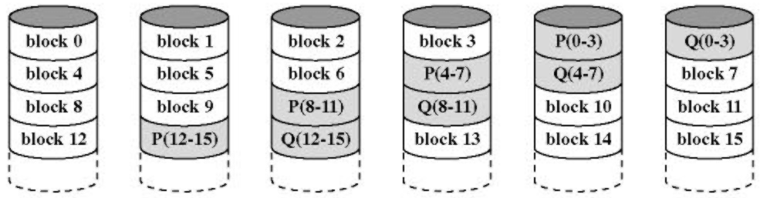
RAID (continued…)
RAID 6: Independent Access w/Error Correction
Use two different data check methods
Can handle a double-disk failure
Extremely high data availability w/substantial write penalty

Slide 36
RAID Level Summary
Category
Description
I/O Request Rate
(Read/Write)
Data Transfer Rate
(Read/Write)
Typical Application
Striping
0
Non-redundant
Large strings: Excellent
Small strips: Excellent
Applications requiring high performance for non-critical data
Mirroring
1
Mirrored
Good/fair
Fair/fair
System drives; critical files
Parallel access
2
Redundant via Hamming code
Poor
Excellent
3
Bit-interleaved parity
Poor
Excellent
Large I/O request size applications such as imaging, CAD
Independent access
4
Block-interleaved parity
Excellent/fair
Fair/poor
5
Block-interleaved distributed parity
Excellent/fair
Fair/poor
Applications requiring extremely high availability
6
Block-interleaved dual distributed parity
Excellent/poor
Fair/poor

Slide 37
Disk Cache
Similar concept to memory cache
Use main memory to hold frequently used disk blocks to exploit the principle of locality
Can afford more complex algorithms due to the time factors involved
Handling a request
If the data is in cache, pass it to the user (copy or use shared memory)
If not in cache, read from the disk and add to the cache
Replacement algorithms
LRU – Can keep a list and determine the one not used for most time
Most commonly used algorithm
LFU (least frequently used)
Account for how often it is used
Watch out for burst of uses, then idle
Improved performance w/frequency-abased

